Slide 1
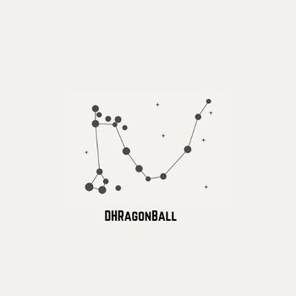


Carlo Marlati
Johana Havrdová
Kateryna Korkushko
Lorenza Amenta
Matteo Epifano
Mariachiara De Alberti
Rita Fastoso
DHRagon ball
Babù
The group project

Slide 2
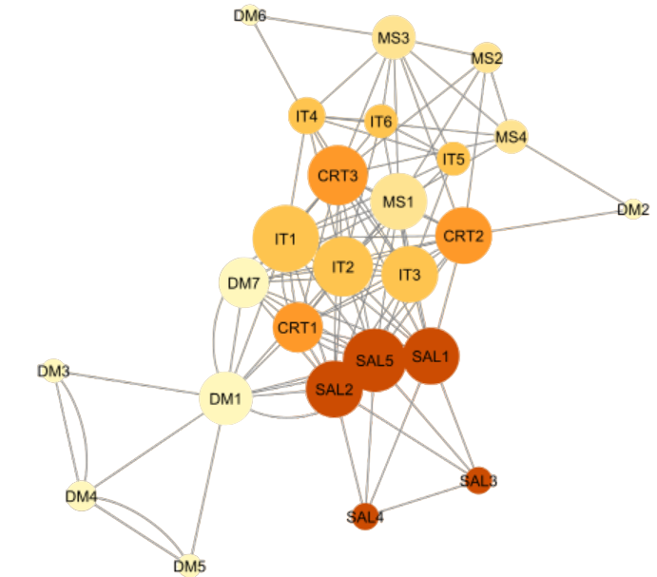
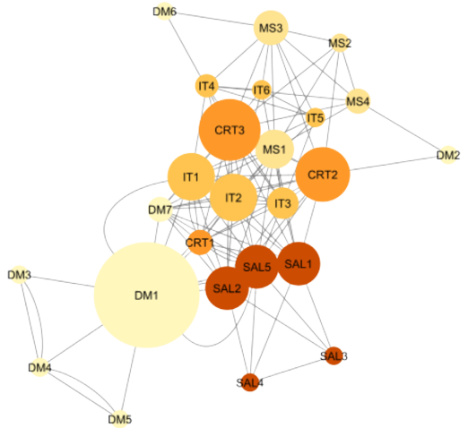
Discover
1. DESCRIBE THE NETWORK STRUCTURE.
First of all, we uploaded and visualized the network with Cytoscape, then we colored the nodes according to their role attribute (see slide 4 for the legend) and applied a layout that uses the frequency of interaction to discriminate between nodes. After trying different layouts, we chose “Edge-weighted spring embedded layout” (using frequency to discriminate between the nodes) because visually we preferred it with respect to other layouts. When analyzing the network structure, we found no evidence of isolated nodes, which means nodes that have zero edgecount. However, we did notice some peripheral nodes (nodes that have relatively few connections compared to other nodes in the network).
[graph 1]
[graph 2]
There are different metrics that highlight which are the peripheral nodes, for instance degree centrality and betweenness centrality. We represented the node sizes according to these 2 metrics.
  Degree centrality measures the number of edges connected to a node. Nodes with a low degree centrality are likely to be peripheral nodes, as they have fewer connections compared to other nodes in the network. [graph 1]
  Betweenness centrality measures the extent to which a node lies on the shortest paths between other nodes. Nodes with low betweenness centrality are less likely to be on the main paths of communication and can be considered peripheral. [graph 2]
Taking a look at the two options above, we preferred using “degree” as the final metric for the nodes’ size. We believe the size of the node DM1, using betweenness metric, is too big and it could be misleading. [graph 2]

Slide 3
Discover
2. INTERPRET THE FINDINGS.
Looking at the voice “edgecount” on the table panel (this shows the number of connections within the network), nodes DM2 and DM6 have only 2 links, DM3 and DM5 only have 3 links, DM4 has 5 links while
DM7 has 11 and DM1 has 12.
  MAIN CRITICALITY: the majority of the digital marketing specialists appears to be quite peripheral compared to the other nodes of the network. In particular:
  DIGITAL MARKETING SPECIALISTS DM2, DM6 and DM7 have some links with other functions (marketing specialists and designers), but they are not connected between them and to their boss (DM1) >>> it is crucial that they communicate between them and that they have a relationship with their boss!
(note: they are also not connected to the other digital marketing specialists DM3 DM4 DM5)
  DIGITAL MARKETING SPECIALISTS DM3 DM4 DM5 : these roles are also in a peripheral position but at least they are connected between them and their boss (DM1). >>> what about the communication with other functions?
On the next slide there is the final output of our network analysis.
(note: in the final output we changed the colors and used a darker tone for the manager of each area)

Slide 4
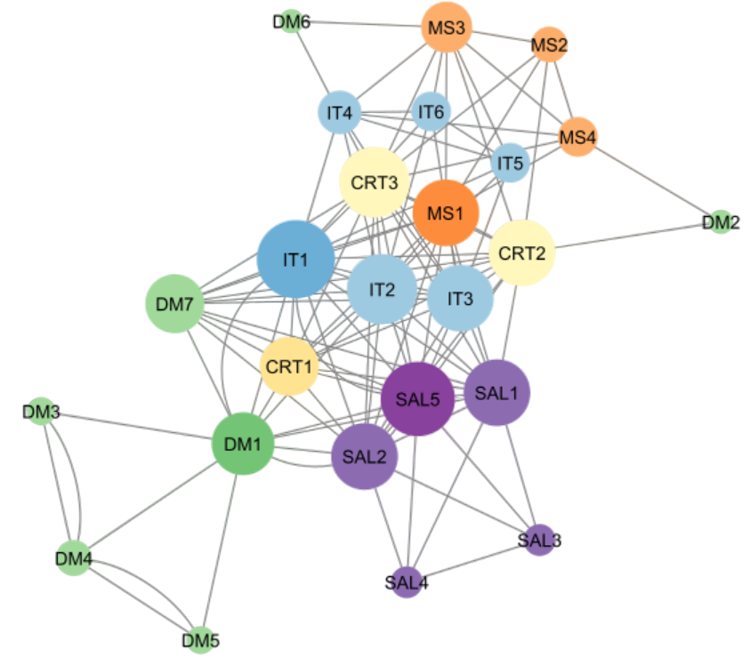
Legend
Green: digital marketing specialists
  Dark green: digital marketing manager
Lilac: sales specialists
  Purple: sales manager
Light blue: IT specialists
  Blue: IT manager
Yellow: designers
  Deep yellow: creative manager
Light orange: marketing specialists
  Orange: marketing manager

Slide 5
Propose
3. DISCUSSING THE FINDINGS: RISKS
  Turnover remains high; if nothing changes, the high turnover ratio will definitely not decrease over time. This is the key problem and it is a structural issue and not a phenomenon related to contextual factors, which means that it is very unlikely to be temporary.
  Lower engagement and low job satisfaction: a high turnover, as well as a social network where key individuals are kept peripheral, will lead to an environment that does not promote putting efforts in socializing and creating new links. For example, employees won’t know if the newly hired person will stay in the company for a long time, promoting uncertainty. All this together leads to the perception of a workplace that does not care for its employees, which has been proven to be one of the main drivers of low job satisfaction. This can manifest in the form of quiet quitting even among employees belonging to other units, with potentially catastrophic consequences.
  Well-being and psychological risks: a fragmented social network may lead to alienation for some employees, given the lack of clarity regarding the hierarchical structure and the congested information flows. Employees that don’t know who to talk to and who to cooperate with will feel abandoned by their company.
  Contagion theory: this theory suggests that an employee’s propensity to leave a job can be influenced by whether other employees have also left their jobs or are intending to do so. Employees compare themselves and their attitudes to others to determine if they should leave. This provides both an additional explanation to the high turnover ratio, and at the same time constitutes an additional challenge, suggesting that the turnover ratio should be minimised. [8, pp. 252]
  Peripherality: research shows clearly that the average number of connections required to reach all other employees in the organisation influences turnover. Employees whose connections operate on the periphery are more likely to leave. This suggests that keeping key employees at the periphery of the social network puts the company more at risk of losing them. [8, pp. 261]
  Higher costs: a high turnover ratio translates directly into huge costs for the company, of various nature. Some of the most relevant are: administrative costs, hiring costs, training costs, as well as indirect costs such as the line managers’ time (he has to devolve some time to align employees to company’s objective) or overworking risks for other team members (they have to compensate the missing work of the leaving employees). [2, pp. 630]
  External networking behaviour: scholars have found that employees’ behavioural frequency of building and maintaining ties with people outside the firm was POSITIVELY correlated to turnover. If employees do not develop enough connections with their co-workers, there is a higher probability that they will develop connections outside of the company, leading to increased risk of leaving the company [8, pp. 256]
  Reputation risks and negative influence on employer-branding: a high number of employees leaving your company, especially after a short time, will negatively impact your reputation, especially among professionals of the selected sector, making it substantially difficult to acquire new talents.
  Shortage of critical knowledge: it is imperative that the company retains the individuals that possess the critical knowledge of interest, otherwise it risks to be left behind by its competitors and loose its position on the market.

Slide 6
Propose
4. DISCUSSING THE FINDINGS: ACTIONS
  Before implementing anything specific, we must make sure that managers have awareness of the current state: this can be achieved through presenting them with some social networking analysis, explaining them the correlation with turnover rate, and integrating with reports about the satisfaction of the employees. [2, pp.629] The main goal is to restructure the social network of the business unit of interest. Our ideal structure is similar to the one already existing (SAL#). We need a team leader (DM1), representing the main bridge with the other units, with direct connections with everyone in the DM unit, to align everyone’s work towards the main focus. We advise to implement a secondary coordinators with connections with employees from other business units, to achieve the double objective of reducing risk of overworking the line manager, and provide a safety net in case the line manager leaves the company. For this role we considered DM7, which has large amount of connections outside of their unit. Ideally all the DMs would be connected to each other, to the point of achieving the formation of a “clique” [see glossary], reducing to the minimum the necessity of intermediaries within the unit and boosting teamwork and knowledge.
  Learning from what works: an interview could be held with the DM7 individual, because this person formed a great number of ties with other co-workers. Analysing their approach to networking could give great insights to improve the processes. We examine this employer’s intentions to leave the company. It will give us a better understanding if the employer is the advise-giver to their network and if this behaviour is adequately monitored and rewarded by the manager. [5, pp. 578]
  Improve the on-boarding process: studies found that the ties that are created during the first few months of a new working environment are on average among the strongest. Promoting the formation of new and stable ties during the onboarding process can be a great way to enhance retention. This can be achieved through different ways, such as imposing physical proximity, [2, pp.632] which has also been proven to improve the number and consistency of ties [1, pp. 20] and to enhance the knowledge-spilllover effect. Early connections between newcomers and more seasoned employees make it more likely for the former to stay. Well-crafted onboarding program is the instrument to build connections between newcomers and other employees within the organisation. [7, pp3]
  Improving social inclusion: providing opportunities for informal interactions are a great way to give employees more time to bond and develop informal connections. [2, pp. 633] Another way to achieve this could be to improve on the usage of new interactive technologies to reduce the social distance between supervisors and subordinates, such as videoconferencing and internal social media. (Stone, D., Deadrick, D.L., Lukaszewski, K.M., & Johnson, R. (2015). The Influence of technology on the future of human resource management).
  Creating coaching and mentoring programmes that involve multiple people: the quality of an employee’s social relationship with one primary mentor had no association with turnover, whereas the quality with an entire set of mentors at work reduced the likelihood of turnover. [8, pp. 271]
  Recognition: compare the salaries with the market benchmarks and make sure you’re being at least in line with them. Payment must be coherent with the role [2, pp. 634]. Managers need to acknowledge and reward contributions that exceed expectations, as well as behaviours that go beyond their job description . We also pay special attention to the role of manager of the unit, not only from the organisational chart prospective, but as to the leader and the manager. Teamwork and trust are crucial. Employees should feel valued by the employer, if they are - they are motivated to do their best. [4, pp 46]. Latest research say that round 35% of employees leave the company because of an uncaring leader. [5]

Slide 7
Propose
5. DISCUSSING THE FINDINGS: EVALUATION
  Turnover rate: self-explaining, consists of the number of DM employees who left over the number of DM employees within the digital marketing department.
  Voluntary turnover rate: alternative measure to turnover rate, helps us get a cleaner look to what we would actually like to boost and eliminates elements outside of our control (firings, transfers due to family issues, etc.). Voluntary departures/average of total employees (only for the DM Unit).
  Average length of employment: total number of years of employment for DM/total number of employees. It is an additional metric, but not necessarily the most important.
  Job Satisfaction Rate: we would like to create a metric called “Job Satisfaction Rate”, that takes from the notion of job satisfaction (High job satisfaction helps to decrease turnover and absenteeism, as well as has a positive affect on task performance behaviour, contextual performance behaviour and customer satisfaction) and is defined as a combination of different sub-metrics that includes elements such as (some of these have been gathered going through academic papers to get a better understanding of what has been found to be effective [1, pp. 32]): perceived mismatch between job description and actual job practices on the workplace; (perceived effectiveness of the onboarding process, thoughts of quitting, perceived Stress, psychological Safety, perceived Job Recognition (in its many forms), eNPS (employee net promoter score) - on a scale from 1 to 10 how likely is the candidate to recommend “Babù” as a place to work (after the responses, the survey reveals three profiles: promoters, detractors and passive). The alternative can be ESI. All of these elements can be gathered through surveys (even anonymous ones) and interviews.
  Degree of centrality: number of total connections, basic metric used for the analysis of social networks in multiple scenarios [2, pp. 631].
  Frequency of interaction: a metric that periodically measured over a specific time frame the amount of interactions between members. This helps to keep track on a micro level of how things are evolving and allows to notice potential issues between two nodes and intervene quickly.
  Tie Strength: frequency of interactions over time, especially if combined with metrics such as reciprocity and/or surveys where we ask to evaluate the level of intimacy of a bond, can be used to estimate tie strength. High tie strength is highly desirable.
  Density: number of connections a participant has over the total possible connections a participant could have. We could set a target level of density that we would like the employees to achieve.

Slide 8
References
[1] Chen, H., Mehra, A., Tasselli, S., & Borgatti, S. P. (2022). Network Dynamics and Organizations: A Review and Research Agenda. Journal of Management, 48(6), 1602–1660.
[2] Cross, R., Kaše, R., Kilduff, M. and King, Z. (2013), Bridging the Gap between Research and Practice in Organizational Network Analysis: A Conversation between Rob Cross and Martin Kilduff. Hum. Resour. Manage., 52: 627-644
[3] Zajec, S., Mrsic, L., Kopal, R. (2021). Managing Human (Social) Capital in Medium to Large Companies Using Organizational Network Analysis: Monoplex Network Approach with the Application of Highly Interactive Visual Dashboards. In: Gupta, D., Khanna, A., Bhattacharyya, S., Hassanien, A.E., Anand, S., Jaiswal, A. (eds) International Conference on Innovative Computing and Communications. Advances in Intelligent Systems and Computing, vol 1166. Springer, Singapore
[4] Future of Work Trends in 2022: The new era of humanity. (2021). www.kornferry.com. https://www.kornferry.com/insights/featured-topics/future-of-work/2022-future-of-work-trend
[5] Soltis, Agneessens, F., Sasovova, Z., & Labianca, G. (Joe). (2013). A Social Network Perspective on Turnover Intentions: The Role of Distributive Justice and Social Support. Human Resource Management, 52(4), 561–584
[6] De Smet, Dowling, B., Mugayar-Baldocchi, M., & Schaninger, B. (2022). Gone for now, or gone for good? How to play the new talent game and win back workers. The McKinsey Quarterly.
[7] Soltis, S. M., Methot, J. R., Gittell, J. H., & Harris, T. B. (2023). Leveraging relational analytics in human resource research and practice. Human Resource Management, 1– 13
[8] Jo, J., & Ellingson, J. E. (2019). Social Relationships and Turnover: A Multidisciplinary Review and Integration. Group and Organization Management, 44(2), 247–287.

